Slide 1
Baby, It’s Cold Out There! Hypothermic Cardiac Arrest
Bradford L. Walters, MD, FACEP
William Beaumont Hospital
Department of Emergency Medicine
Royal Oak, Michigan

Slide 2
Conflicts of Interest
No sponsors.
No conflicts of interest.
As always my goal in life is to be the person my dog, Winston, believes I am.
Winston has one potential conflict in that he is the mascot of the Michigan College of Emergency Physicians.

Slide 3
Introduction
Hypothermic Cardiac Arrest
Due to severe hypothermia leading to cardiovascular instability and as it progresses to cardiac arrest.
This is in contrast to therapeutic hypothermia.
Organ systems require a narrow range of temperatures to function properly.
At risk populations include:
Winter sports enthusiasts, most often in good health.
Urban poor, often with multiple medical problems, malnutrition, ETOH/drug abuse.
Cold water immersion accidents.
Three levels of hypothermia based on core temperature:
Mild = 32 – 35ºC
Moderate = 30-32ºC
Severe = < 30ºC

Slide 4
Pathophysiology of Hypothermia
As core body temperature falls a number of detrimental things happen all of which result in a reduction of organ perfusion:
Myocardial contractility is reduced.
Left shift of the oxygen-dissociation curve reducing oxygen delivery to the tissues (Hgb holds unto O2 and does not release it at the cellular level).
Vasoconstriction.
Increased blood viscosity.
Cold diuresis reduces vascular volume
Initially an increase in sympathetic drive induces shivering, tachycardia, and tachypnea however at 30ºC shivering stops and one sees hypotension, bradycardia, reduced respiratory rate, and a fall in cardiac output.
That bradycardia leads to atrial fibrillation to ventricular arrhythmias and at 32ºC ventricular fibrillation and finally asystole.

Slide 5
Grade | Temp (C) | Physiologic Changes
Mild | 35 | Maximum shivering, impaired judgment
 | 34 | Increased HR, RR, SVR, cold diuresis
 | 33 | Bradycardia, respiratory depression, hyperglycemia, ataxia
Moderate | 32 | Stupor, lethargy, arrest of shivering
 | 31 | Atrial arrhythmia, Osborn J-waves, worsening bradycardia
 | 30 | Insulin resistance, decreased O2 consumption
 | 29 | Progressive decreased LOC, HR and RR continue to fall
Severe | 28 | Susceptible to VF, HR and O2 consumption down by 50%`
 | 27 | Loss reflexes and voluntary movement
 | 26 | No response to pain, acid-base disturbances
 | 25 | Cerebral blood flow down by 66%, pulmonary edema, apnea
 | 24 | Hypotension
 | 23 | Corneal and oculocephalic reflexes absent
 | 22 | Maximal risk for VF, O2 consumption only 25% of normal
Profound | 20 | Lowest resumption of cardiac activity, pulse 20% of normal
 | 19 | asystole

Slide 6
Pathophysiology
YOU ARE NOT DEAD UNTIL YOU’RE WARM AND DEAD.
When in doubt as to patient status start CPR.
Numerous examples of recovery from prolonged circulatory arrest (almost all in children or fit individuals).
Lowest neurologically intact survival was from 13.7ºC due to immersion injury.
Be prepared for a prolonged resuscitation effort in hypothermic cardiac arrest patients – plan your resources accordingly.

Slide 7
Clinical Assessment - Temperature
Essential to accurately measure core body temperature, not as easy as it might seem.
Regular electric thermometer does not go low enough.
Thermistor probe is the best device.
Rectal temperature can be hampered by feces.
Esophageal probe is likely the best such as those used for cooling blanket or Bair Hugger however, heated, humidified air used can cause false readings.
Vascular temperature probe is most accurate but least accessible.
A primary question that needs to be asked is the cardiac arrest a primary event causing hypothermia or is hypothermia the cause of the cardiac arrest:
For a cardiac arrest to be due to a low core body temperature it has be at least in the severe level.
If the patient is mild/moderate hypothermia and is having a cardiac arrest it is most likely that the arrest is due to a cardiac event, such as AMI, as the primary cause.
History:
Where found, how cold was the environment, how long was the patient in that environment.
What were they wearing, are they wet, immersion accident.
Co-morbidities, ETOH use, drug use.

Slide 8
Labs & Expected Derangements
Labs: CBC, BMP, LFT’s, ABG, Ca, Mg, PT/PTT, amylase are suggested.
Alterations is lab values due to hypothermia:
Hypoglycemia or electrolyte derangements – treat as usual to correct.
K+ goes into cells, treat hypokalemia if severe but as re-warm K+ will come back out into serum with resulting hyperkalemia, supplement sparingly.
Severe hyperkalemia usually due to cell necrosis, > 10 mEq/L stop resuscitation.
Elevated creatinine does not always reflect renal function.
DIC-like coagulopathy is often seen.
Fluid loss results in elevated hematocrit ~2% increase for every decrease of 1ºC.
Thrombocytopenia seen due to splenic sequestration and bone marrow suppression.
ABG’s – machine warms blood to 37ºC, in times past there were calculations that took into account the decreased core body temperature but they were not so severe as to be clinically relevant, use the blood gas results as they come back; acidosis is common.

Slide 10
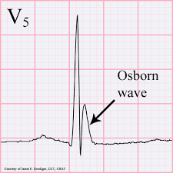
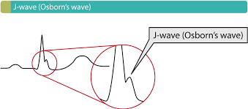
Osborn J-Wave

Slide 11
Management
If in cardiac arrest (no pulse, no BP, not breathing) – START CPR, intubate, establish IV access.
Re-warming – as rapidly as possible:
Remove wet clothes, dry off.
External warming – Bair Hugger, cooling blankets set to re-warming (Artic Sun), heated humidified oxygen, warm IV fluids – quick, easy, non-invasive, essential not only to help re-warm but to prevent heat loss.
Internal warming – 3-way Foley catheter with warmed fluid irrigation, peritoneal lavage catheter placement with warmed fluid irrigation.
ECMO/cardiopulmonary bypass – the most invasive but most effective means of re-warming, takes longest amount of time to institute (might need the OR), least available.
RE-WARMING IS THE MOST EFFECTIVE INOTROPE AND ANTI-ARRTHYMIC AGENT!

Slide 12
Re-warming Methods and Rate of Warming per Hour
Classification of Rewarming | Method | ~ Rate ºC/hour
External passive | Remove wet clothes, blankets, warm drinks | 0.5 - 4
External active | Forced air heat (Bair Hugger) | 1 – 2
 | Hot water immersion | 2 – 4
 | Inhalation warmed air | 0.7 – 1.2
 | Warmed IV fluids | Variable
Internal active | Body lavage – peritoneal, bladder | 1 – 3
 | Hemodiafiltration | 2 - 3
 | Cardiopulmonary bypass | 7 - 10

Slide 13
Cardiac Arrest Management
Once cardiac arrest is confirmed:
Begin CPR.
Undress, dry off, get core body temperature, START RE-WARMING AS FAST AS POSSIBLE.
Look of co-morbidities, consider other diagnoses, remember “H’s and T’s”.
Defibrillation:
Less effective in hypothermia, for VF/VT try three times, then hold off until core temperature > 30ºC.
Pacing is ineffective, attempt if bradycardia persists despite reaching core temperature > 30ºC.
Intubation, Ventilation:
If have a perfusing rhythm consider holding off intubation as rough handling could precipitate VF, though evidence is mainly animal based and very rare.*
Normal pCO2 will be achieved at lower minute volumes, hyperventilation can risk cerebral hypoxia and reduced perfusion, aim for normal pCO2 on uncorrected ABG.
Drugs:
Typically ineffective until reach core temperature > 30ºC, then given at twice the time interval until reach normothermia or core temperature > 35ºC or circulation restored.
For example epinephrine would be given every 8-10 minutes.
Presenter’s note: Do not hesitate to establish a definitive airway over concerns that the act of intubation will precipitate VF, maintaining adequate oxygenation and heated inspired air are extremely important steps in resuscitation.

Slide 14
Cardiopulmonary Bypass
CPB/ECMO is the fastest means of rewarming with a rate of 1 – 2 ºC every 5 minutes being achieved.
Indicated for hypothermic patients with a core temperature < 32ºC in cardiac arrest, with hemodynamic instability, frozen extremities, and rhabdomyolysis with hyperkalemia.
Femoro-femoral or aortic-right atrial bypass is recommended, “fem-fem” bypass is the most available type in the emergency department (chest compressions will need to be continued in “fem-fem” bypass to establish flow through the machine).
Opening up the chest is no longer recommended due to the uncontrolled loss of heat from the open chest – irrigation through chest tubes is also no longer recommended.
Re-warming shock is seen with cardiovascular collapse due to poorly understood reasons such as electrolyte shifts or temperature fluctuations as cold blood returns from the extremities; additional volume loading and continued CPR may be necessary to treat.

Slide 15
Mortality, Morbidity, Futility
Survival rates of up to 50% with CPB have been seen in reports out of Great Britain.
Best outcomes from ED’s that commonly deal with cold weather sports enthusiasts or accidental immersion cases.
Common issues in survivors include ARDS, AKI/ARF, pneumonia all of which complicate recovery.
Majority of survivors have a good neurological outcome.
Majority of deaths seen with those who fail to be weaned off bypass.
Futility and when resuscitative efforts should be stopped include:
K+ > 10 mmol/L or severe traumatic injuries.
Death can be confirmed if there is no perfusing rhythm and -
Patient has been rewarmed or:
Other nonsurvivable injuries have been identified or:
Re-warming has failed despite available resources

Slide 16
Summary
It can be challenging to find evidence of cardiac output in hypothermic patients.
If in doubt start CPR, pretty much with standard BLS/ACLS standards.
A key is accurate core body temperature measurement, esophageal likely the best.
Expect a prolonged period of resuscitation and plan accordingly.
Drugs should not be given if core temperature is < 30ºC, once above that give at twice the normal time intervals until normothermic.
Defibrillation is less effective at core temperature < 30ºC and only try a maximum of three times if below that temperature and wait until the patient is rewarmed over 30ºC.
The most effective antiarrhythmic and inotropic agent is rewarming the patient.
Cardiopulmonary bypass rewarms the fastest but least accessible – heated inspired air, Bair Hugger, lavage (peritoneal and bladder), heated IV fluids should all be used as well.
Prognosis is better with hypothermia than in other non-traumatic cardiopulmonary arrests so be aggressive but, know when the stop resuscitative efforts.

Slide 17
Selected Bibliography
Harris T, Jones JM. Cardiac arrest in special circumstances: hypothermic cardiac arrest. RCEM Learning 3/12/2018.
Gilbert M, Busund R, Skagseth P, et al. Resuscitation from accidental hypothermia of 13.7 C with circulatory arrest. Lancet 2000;355:375-376.
Ulrich AS, Rathlev NK. Hypothermia and localized cold injuries. Emerg Med Clin N Am 2004;22:281-298.
Mattu A, Brady W, Peron A. Electrocardiographic manifestations of hypothermia. Ann J Emerg Med 2003;10:187-191.
Walpoth B, Walpoth-Asian B, Mattle H, et al. Outcome of survivors of accidental deep hypothermia and circulatory arrest treated with extracorporal blood warming. NEJM 1997;337:1500-1505.
Farstad M, Andersen K, Koller M, et al. Re-warming from accidental hypothermia by extracorporal circulation. Eur J Cardiothorac Surg 2001;20:58-64.
Vretenar DF, Urschel JD, Parrot JC, et al. Cardiopulmonary bypass resuscitation for accidental hypothermia. Ann Thorac Surg 1994;58:895-898.

Slide 18
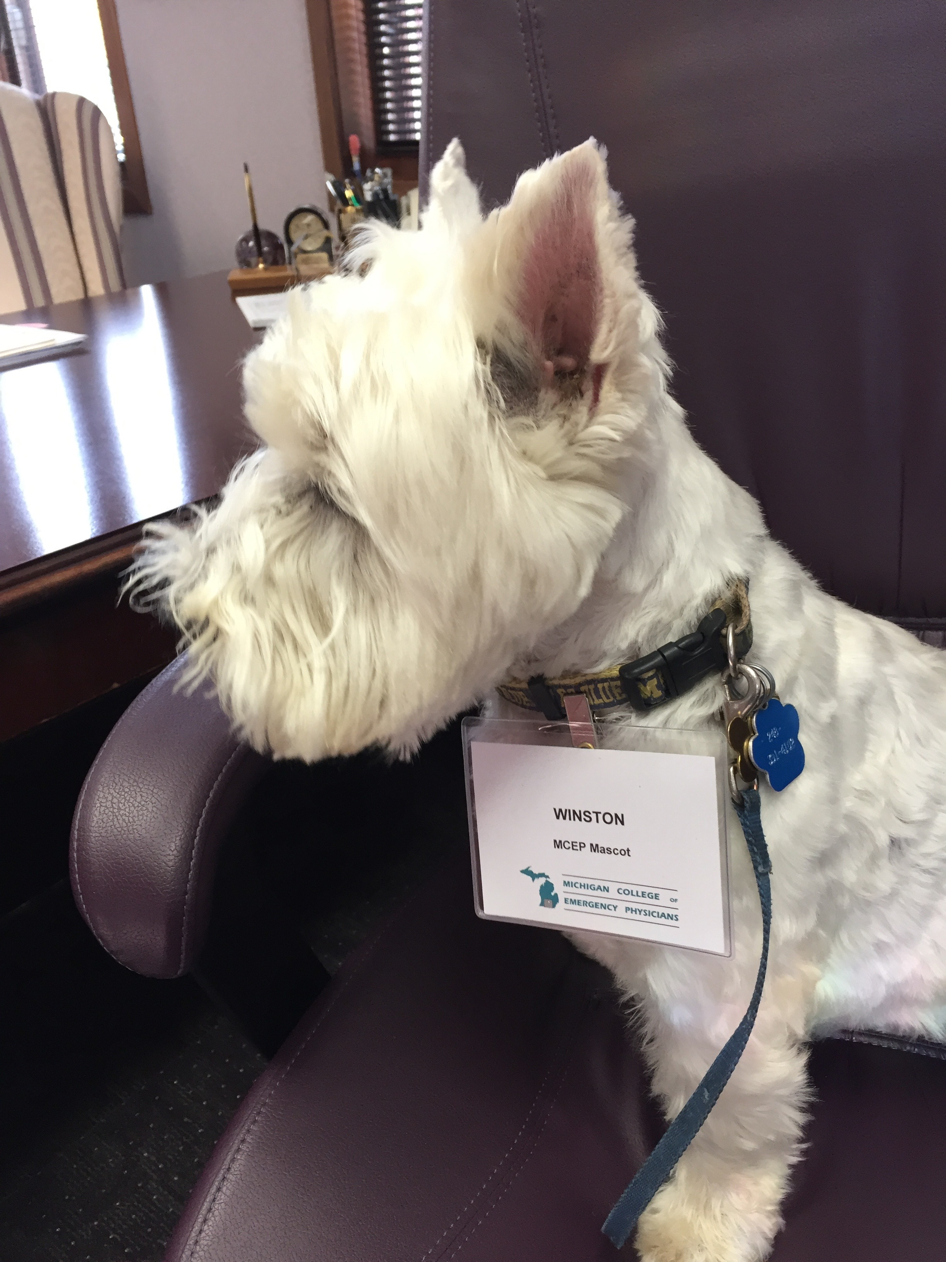
Winston and I thank you for your kind attention.
Questions?

